Slide 1

Chat Automation In a modern IT environment
Jaap Brasser
@jaap_brasser

Slide 2


jaapbrasser.com/about
PowerShell Conf EU/Asia
Dutch PowerShell User Group
Blogging
PowerShell Gallery
TechNet Forums/Gallery
@Jaap_Brasser

Slide 3
Agenda
Chat automation
What tools
How to deploy
Manage security
Demos!

Slide 4

Agenda
Differences between editors
Configure VSCode
Working with Vscode
Setting up the ISE
Working with the ISE and ISESteroids
Questions
What is Chat Automation?

Slide 5

Agenda
Differences between editors
Configure VSCode
Working with Vscode
Setting up the ISE
Working with the ISE and ISESteroids
Questions
But why use chat?

Slide 6
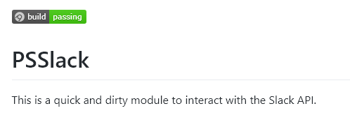



What tools are we using today?

Slide 7

Agenda
Differences between editors
Configure VSCode
Working with Vscode
Setting up the ISE
Working with the ISE and ISESteroids
Questions
Demo
Deployment

Slide 8
Demo Summary
Created Slack API Token
Installed PoshBot
Configured PoshBot
Showed basic functionality
Install additional modules

Slide 9

Agenda
Differences between editors
Configure VSCode
Working with Vscode
Setting up the ISE
Working with the ISE and ISESteroids
Questions
What is next?

Slide 10

Agenda
Differences between editors
Configure VSCode
Working with Vscode
Setting up the ISE
Working with the ISE and ISESteroids
Questions
Security

Slide 11
Agenda
Differences between editors
Configure VSCode
Working with Vscode
Setting up the ISE
Working with the ISE and ISESteroids
Questions
Demo
Team interaction

Slide 12
Demo Summary
Analyzed problem
Contacted engineer
Engineer resolved problem
No RDP required

Slide 13

Questions

